Slide 1
Modeling Retirees’ Liquidity Needs
Project Team 11: Jessica Rizzo, Yihang Hu, Haotian Xiang, Mingtao Jia, and Haoyang Wang
Sponsor Participants: Dr. Sudipto Banerjee, and Dr. Louisa Schafer
Project Advisor: Dr. David Ruppert
Notes:
1

Slide 2
Content
Introduction and Objectives
Data Description and Processing
Methodologies
Results and Conclusions
Limitations
Acknowledgements
Reference
Q&A
Notes:
2

Slide 3
Introduction and Objective
Notes:
3

Slide 4
Introduction and Objective
The T. Rowe Price Group is an asset management firm. We are collaborating with the Lifecycle Research Team who are interested in investigating and modeling the spending patterns of retirees.
However, modeling liquidity needs is a complex task. Our project focuses on a more concrete subtask: simulating out-of-pocket medical spending based on age and health status.
Demographic models of investors’ earnings, savings, and spending behavior
Out-of-pocket medical spending based on age and health status
Notes:
4

Slide 5
Data Description and Processing
Notes:
5

Slide 6
The Health and Retirement Study
Conducted by the Institute for Social Research at The University of Michigan. We use a cleaned version of the data published by the RAND Center for the Study of Aging.
Surveys individuals over the age of 50 and their spouses about health status, medical spending, income, assets, and insurance.
Longitudinal data. The same individuals are re-surveyed in successive waves providing an archive of health and spending data.
The subset we utilize is composed of 12 waves, collected on biannual basis from 1998-2020 and contains only publicly available data.
Notes:
6

Slide 7
Selection of Variables
To construct a snapshot of “health status” we use the following subset of variables:
Variable Category
Health Services
Health Status
# of Doctor Visits, # of nights in nursing home nights, # of nights in hospital, Special Facility*, Outpatient*, Home Care*, Drugs*
High Blood Pressure*, Arthritis*, Cancer*, Psych*, Lungs*, Heart Attack*, Stroke*, Health Change
* refers to indicator variables
Notes:
7

Slide 8
Selection of Individuals
The training dataset should be representative of the T. Rowe customer base and relatively complete.
Therefore, we will include individuals in the training dataset once (and if) they meet the following criteria:
Age 65 or older
Covered by Medicare
Greater than $1000 in liquid assets
Less than 2 NA values
Observed for 5 or more waves (10 or more years)

Slide 9
Adjusted Out-of-Pocket Medical Spending
The outcome variable for our model is adjusted out-of-pocket medical spending. For our purposes, “adjusted” means the raw spending values have been:
Adjusted to 2020 prices using the priceR package.
Divided by (average) social security income to adjust for financial position.

Slide 10
Methodologies

Slide 11
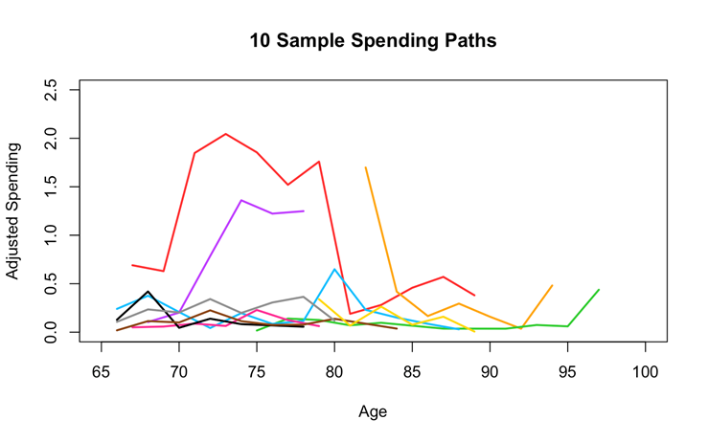
The Goal
Our goal is to build a simulation model which can reproduce spending paths with the same statistical properties as the training data. Our model must fit into T. Rowe’s existing simulation framework; thus the only input can be age. Therefore, the simulation must contain:
a mechanism to simulate health status based on age and
a model for spending based on health status.
10 randomly sampled “spending paths” from our training dataset.

Slide 12
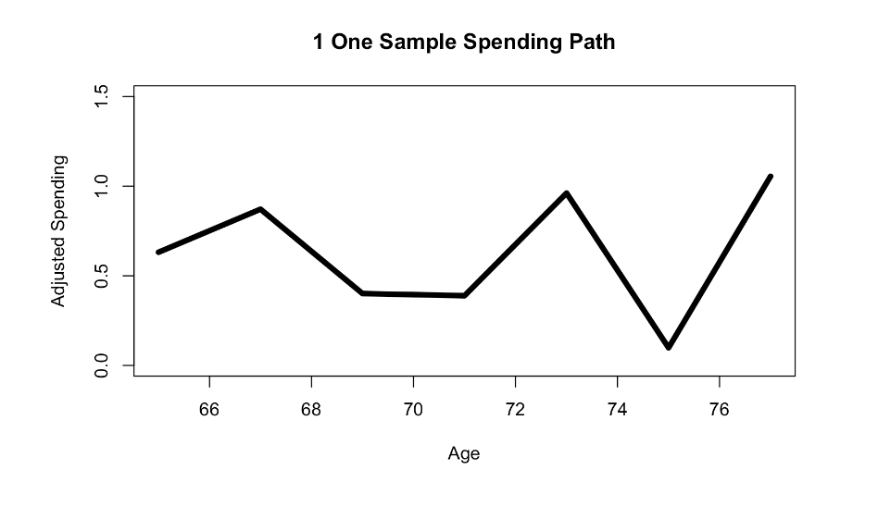
Health Shocks
Health shocks have many causes: a trip to the hospital, a new diagnosis, etc. They are the single biggest factor for determining spending.
We use two different methodologies for simulation which differ in:
how they account for health shocks and
the method used for simulating the joint distribution of health variables.
One sample spending path from the training dataset. Peaks indicate health shocks.

Slide 13
Notes of Regime-Switching
The initial goal was to use regime-switching models to predict spending. A regime switching model relies on the assumption that there is underlying Markov Chain.
One of the assumptions of a Markov chain is that the transition probabilities are homogeneous in time.
For our purposes, that would mean that the probability of experiencing a health shock is constant across age (which does not hold).
Our final two-stage approach captures the structure of a regime-switching without this restrictive assumption.

Slide 14
Method 1
Step 1: Estimating the Probability of a Shock with Logistic Regression
Step 2: Linear Regression
Step 3: Approximating the Joint Distribution of Health Variables
Step 4: Simulation

Slide 15
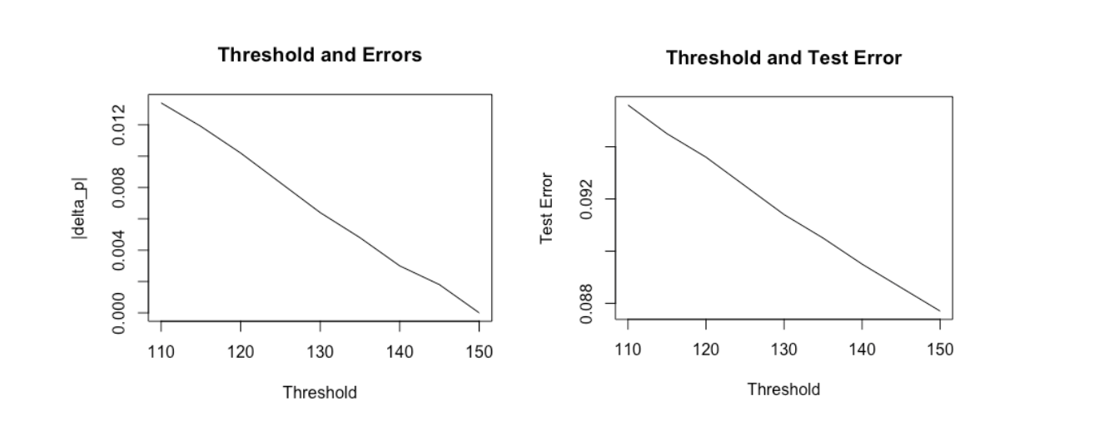
Estimating the Probability of a Shock with Logistic Regression
A shock is defined as a 15% increase in adjusted spending from the non-shock baseline. (Previous research conducted by T. Rowe shows that 15% constitutes a financial hardship.)
Estimated probability of shock 6% vs.
Actual probability of shock 7%
Actual Predicted | Shock | No Shock
Shock | 245 | 696
No Shock | 895 | 15692
Confusion matrix on the test set.

Slide 16
Linear Regression
We then fit a model for adjusted spending on the predicted no shock and shock sets.
Metric | Adj. R² | RSE | MSE
Value | .387 | 1.425 | 2.116
Shock
No Shock
Metric | Adj. R² | RSE | MSE
Value | .128 | 1.265 | 1.646

Slide 17
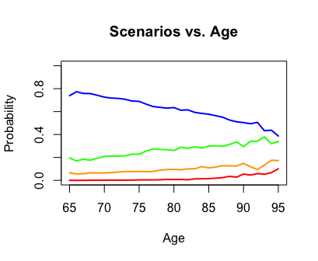
Approximating the Joint Distribution of Health Variables
We simplify the joint distribution by considering the four most common scenarios.
Severe condition includes: Heart Attack, Stroke, Psych, Lungs
Healthy
Hospital (not severe condition)
Severe Condition
Nursing Home
The probability of being healthy decreases with age.
Age

Slide 18
Simulation
We can combine the results from the previous three steps into one simulation engine.
For a simulated person at a given age, we estimate their spending as follows:
Select a health scenario
Based on selected health status, classify the year as a shock year or not
Use either the shock or no shock model to obtain an estimate of adjusted spending
Age

Slide 19
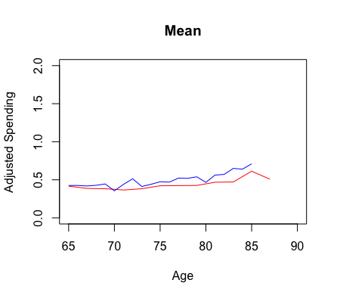
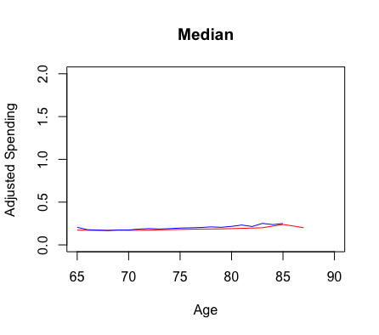
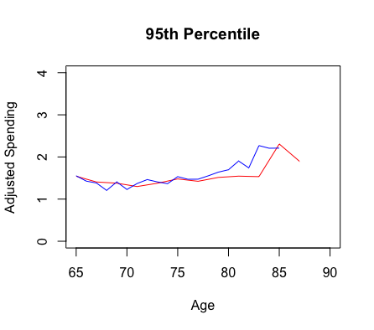
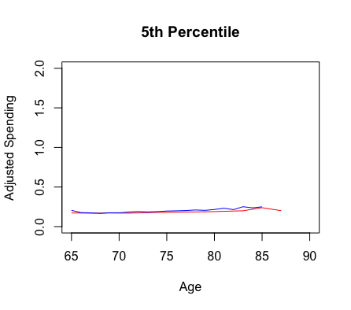


Analysis of Simulation - Aggregate Statistics
Training data
Method 1 shows reasonable performance in all aggregate statistics. There is the most deviation in the upper tail.
Simulated data

Slide 20
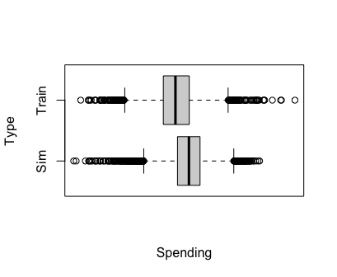
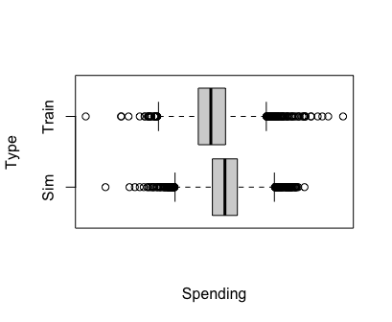
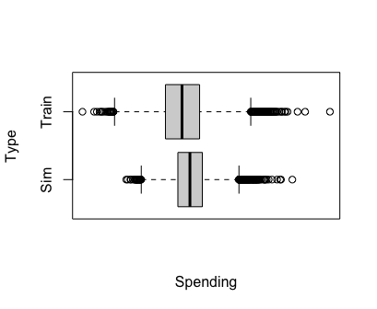
Analysis of Simulation - Inter-Path Variation
Note: the plots show the log of adjusted spending.
Standard Deviation
Avg. % Increase
Max % Increase
Training data
Method 1 shows reasonable performance in all inter-path statistics as well. There is variance in the simulated data.
Simulated data

Slide 21
Method 2
Step 1: Clustering with t-SNE and DBSCAN
Step 2: Linear Regression
Step 3: Approximating the Distribution of Each Variable with FITTER
Step 4: Simulation

Slide 22
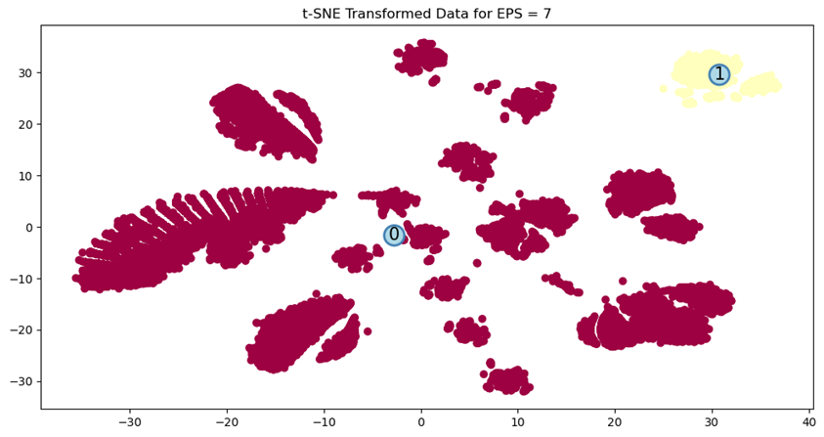
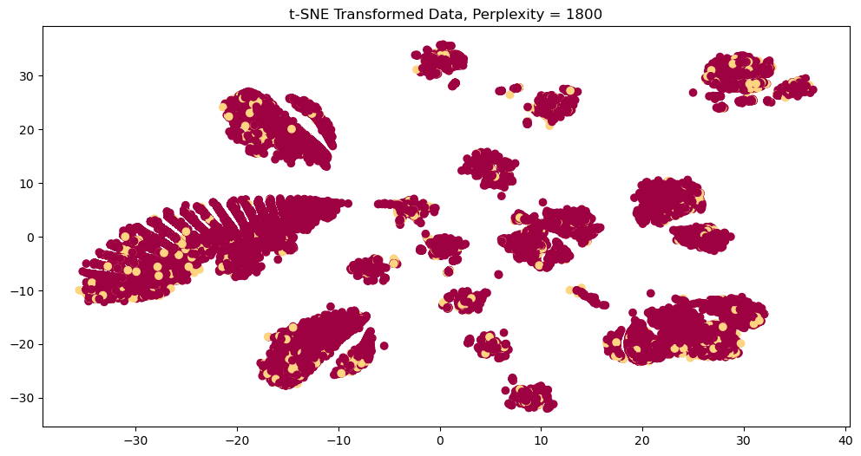
Clustering with t-SNE and DBSCAN
t-SNE is a machine learning algorithm for nonlinear dimensionality reduction.
DBSCAN is a density based clustering algorithm.
We combine these two techniques to construct clusters of similar observations from the data.
We aim to build separate models for each cluster to achieve more representative simulations

Slide 23
Clustering Results
People in High cluster are 40% more likely to experience a wealth shock in the next two years than people in Low cluster.
Cancer and home care appear to be the most significant separating factors.
Cluster | Probability of Wealth Shock
High | 9.37%
Low | 6.74%
All Clusters | 6.93%

Slide 24
PERMANOVA and ANOSIM
PERMANOVA (Permutational Multivariate Analysis of Variance) is a non-parametric multivariate statistical permutation test based on a geometric partitioning of multivariate variation under a chosen similarity measure.
ANOSIM (Analysis of Similarities) is a non-parametric test that determines significant differences between two or more groups using ranked similarity.
For both ANOSIM and PERMANOVA, we reject the null hypothesis and conclude that there are statistically significant differences between the members of each cluster group.

Slide 25
Linear Regression
We then fit a model for adjusted spending on the predicted low and high sets.
Metric | Adj. R² | RSE | MSE
Value | .324 | 3.249 | 4.226
High
Low
Metric | Adj. R² | RSE | MSE
Value | .908 | 2.600 | 4.083

Slide 26
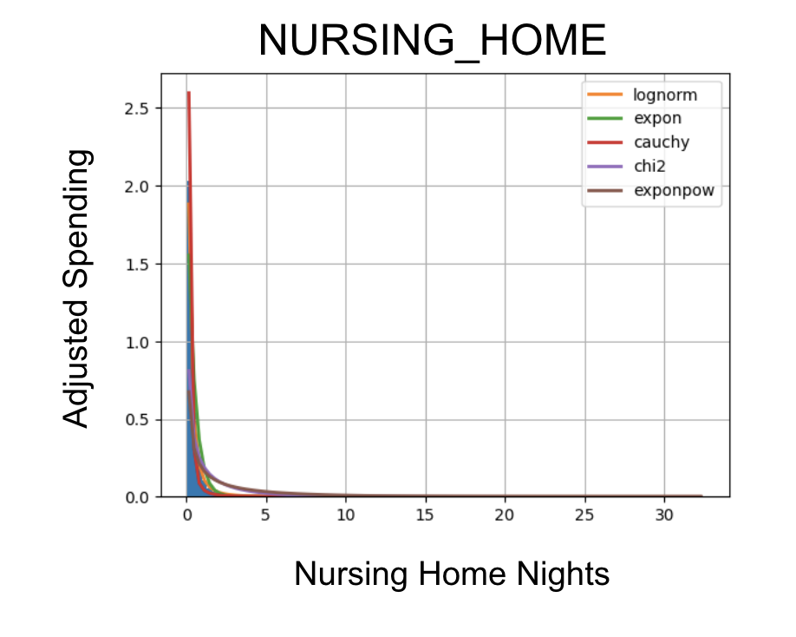
Approximating the Distribution of Each Variable with FITTER
FITTER is a Python package used to fit probability distributions to data.
We apply FITTER to each variable separately to estimate and generate simulations for predictors.
However, it relies on the simplifying assumption that the predictors are independent.
An example for the nursing home variable is shown above.
Age

Slide 27
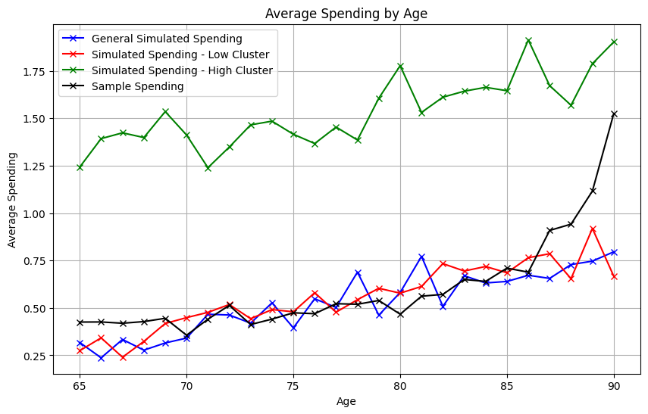
Simulation
We can combine the results from the previous three steps to create a simulation engine.
Age

Slide 28
Results and Conclusions

Slide 29
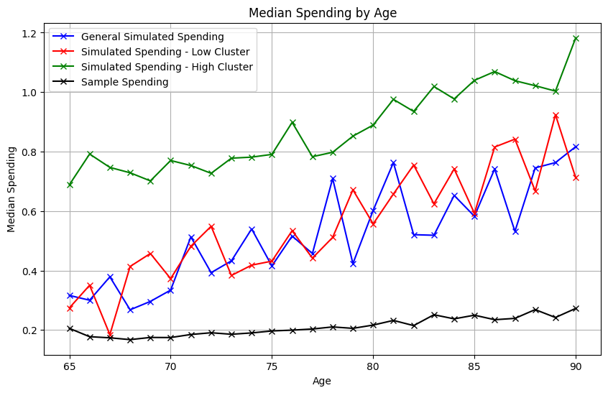
Method 1 vs. Method 2
Training data
Simulated data
Method 2 deviates more on average from the training data than for Method 1, particularly at large values of age. Method 1 is preferred.

Slide 30
Significant Variables from Method 1
Variables | Age | Health Change | High Blood Pressure | Heart Attack | Stroke | Arthritis | Drugs | Special Facility | Doctor | Nursing Home | Hospital | Psych | Outpatient | Home Care | Lungs
Step 1 | ✔️ | ✔️ | ✔️ | ✔️ | ✔️ | ✔️ | ✔️ | ✔️ | ✔️ | ✔️ | ✔️
Shock | ✔️ |  |  |  |  |  | ✔️ |  | ✔️ | ✔️ | ✔️ | ✔️ |  | ✔️
No Shock | ✔️ | ✔️ |  | ✔️ | ✔️ |  | ✔️ | ✔️ | ✔️ | ✔️ | ✔️ | ✔️ | ✔️ | ✔️ | ✔️
The table above summarizes which variables are significant in each model. Backwards stepwise selection was used to identify significant variables.

Slide 31
Significant Variables
Home care: significant separating factor in the clustering and significant in both the Shock and No Shock regression models.
Cancer: the other significant separating factor from Method 2, was not significant in any of the Method 1 models.

Slide 32
Significant Variables
Drugs: the only indicator variables significant in all three models from Method 1 (also the only indicator variable where the mode was 1).
All of the continuous predictors, Age, Doctor, Hospital and Nursing Home: significant in all three models and crucial for approximating health status, so we can conclude these are the three most significant variables.

Slide 33
Conclusions
Method 1 produces a reasonable and accurate simulation of adjusted spending from ages 65-85.
Summary statistics (mean, median, quantiles) and well as measures of inter-path variation (standard deviation, average % change, max % change) are very similar between the training and simulated data.
However, the simulation cannot reproduce the most extreme spikes in spending and becomes unstable at high values of age.

Slide 34
Limitations

Slide 35
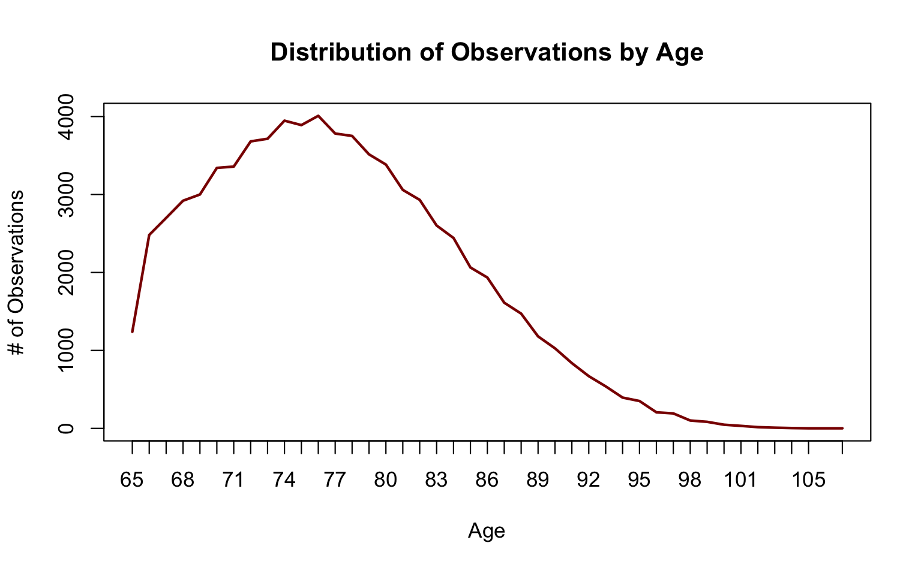
Lack of Training Data at High Age Values
The lack of training data from age 87+ produces unstable estimates of spending at high ages.

Slide 36
Majority Indicator Variables
The predictive power of our model is limited by the majority of our predictors being indicator variables. It is telling that all of the most significant predictors are continuous.
It is also possible that some significant variables were missed in our initial selection. The sheer size and complexity of the HRS makes it impossible to test every combination of predictors.

Slide 37
Limitations of the HRS
Limitations of the HRS. The survey often loses touch with participants who enter assisted living or a nursing home (significant drivers of spending), thus the estimated probabilities of these events are may be, in reality much higher.
RAND Center estimates 56% of people stay at a nursing home at least once in their lifetime (compared to previous conservative estimates of about 35%). Our dataset estimates that probability at about 27%.

Slide 38
Acknowledgements
We would like to thank Dr. Sudipto Banerjee, Dr. Louisa Schafer and T. Rowe Price for the opportunity to work on this project.
Additionally, we would like to express our gratitude to Dr. David Ruppert for his invaluable guidance throughout this project. His expertise and insights have been crucial in shaping the direction and execution of our work.
Last, but not least, we would like to thank Dr. Xiaolong Yang and Prof. Sreyoshi Das for their support during the MPS Applied Statistics Capstone Project.

Slide 39
References
Health and Retirement Study (HRS) Data Products." Institute for Social Research, University of Michigan. Accessed. https://hrs.isr.umich.edu/data-products.
"FITTER: A Python Package for Distribution Fitting." Accessed. https://fitter.readthedocs.io/en/latest/.
"priceR: Economics and Pricing Tools." Accessed. https://cran.r-project.org/web/packages/priceR/index.html.

Slide 40
Q&A

